Slide 1

SALVIA: A software implementation of modern programmable graphics hardware
Ye Wu
ACRD M&E
ye.wu@autodesk.com
Notes:
Good afternoon everyone. Today my topic is an introduction of SALVIA, which is a software implementation of modern graphics hardware.

Slide 2
Introduction
SALVIA: Shading and Lighting Visualization Architecture
graphics hardware simulator
Logic similar with graphics chips
Related projects
MESA
Gallium 3D
Muli3D
SwiftShader
WARP
Our target
High performance in many-core
Advanced features
Notes:
SALVIA is a short name of shading and lighting visualization architecture. It is a graphics hardware simulator. The logic and pipeline of these projects are similar with graphics chips. But the key is all these stages are processed by CPU, not GPU.
Some famous projects were listed on the board.
Well, if you hope it could work more efficiently, or support advanced features, it is not an easy job but our target. To meet the further demands about efficiency and some other things, lots of techniques , such as multi-thread, SIMD instructions and compiler technology have been introduced into our project.

Slide 3
Agenda
Architecture and implementation
Optimization
Notes:
The formal presentation will describe these techniques used in SALVIA. We divide the content into two sections , architecture and optimization.

Slide 4
Architecture
Graphics Pipeline
Shader System
Input Assembler
Vertex Shader
Rasterizer
Blend Shader
Pixel Shader
Shader System
Shader System
Shader System
Notes:
In the section of architecture, graphics pipeline and shader system will be introduced. The diagram is the framework of our job. Vertex shader, pixel shader and blend shader are based on shader system. In the formal presentation, we will talk about the details.

Slide 5
Graphics Pipeline
Pipeline stages
Cooperation: Push or pull model
Choose push model: Explain in the formal
Rasterizer algorithm
Two sorts: scanline and subdivision
Implemented and constrast
Texture sampling operated frequently
Cache friendly texture storage contribute to performance
Back-end
Z test, Alpha test, color blend, etc.
Hardware
finished by fixed pipeline
Blend shader as a complement
Influence the flexibility and performance
Notes:
Next slide is about graphics pipeline. After a brief description about it, I will discuss four topics in detail.
The first one is the cooperation between pipeline stages. We used to have two selections, pull model and push model. Finally, we choose the later and we will explain why we make this decision in the formal presentation .
Secondly, we will talk about algorithm. The algorithm of rasterizer has two sorts, one is traditional scan-line, the other is subdivision which Larrabee used. Both ways we have successfully implemented and we’d like to make a contrast between them in the future.
As we all know that texture sampling is frequently operated in graphics application, considering the fact that cache-friendly texture storage could contribute to the performance, we will discuss this as the third topic in presentation.
At last, we’ll talk about the back-end of SALVIA. Black-end contains lots of operations such as Z test.In hardware, these operations are usually finished by fixed pipeline. As a contrast, in SALVIA, we provide a programmable stage blend shader as a complement. And this change influences the flexibility and efficiency which we will particularly analyze in the formal presentation.

Slide 6
Shader System
Compiling and executing shader
Requirement
Realizing derivative computation
SIMD simulation is necessary factor
Solution
Compiler tool-chains with LLVM
Runtime
Notes:
Next slide is about the shader system. Considering the support from SIMD simulation is a necessary factor to realize derivative computation, we create compiler tool chains and runtime library to solve this problem. The correlative details will be discussed in the formal presentation.

Slide 7
Optimization
 | Multi-thread | SIMD | Just-In-Time | C++ Template
I/O bandwidth | No | No | Yes Remove unused I/O in runtime | No
Latency | No | Yes Operations executed in register | Yes Generate more efficient code by reduce jump instructions | Yes Instead of manual expand code opt
Computation | Yes Thread pool and lock-free for light-weight thread | Yes | Yes Generate optimized code in special case | Yes More opt during compilation
Notes:
We have paid a lot of attention to performance and we find that the system’s slow running is due to the restriction of I/O bandwidth and computation, (这里停顿下)and latency. We have adopted four ways- multi-thread with thread pool and lock-free idiom, SIMD instructions, JIT and C++ template-to resolve these problems. Besides, we will show that how we use these mechanism to realize the optimization.

Slide 8
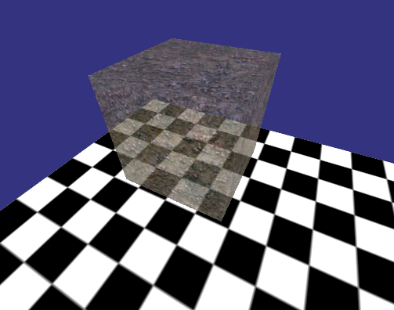
Texturing and color blending
Notes:
Here are two scenes for testing SALVIA’s performance and exhibiting its features.

Slide 9
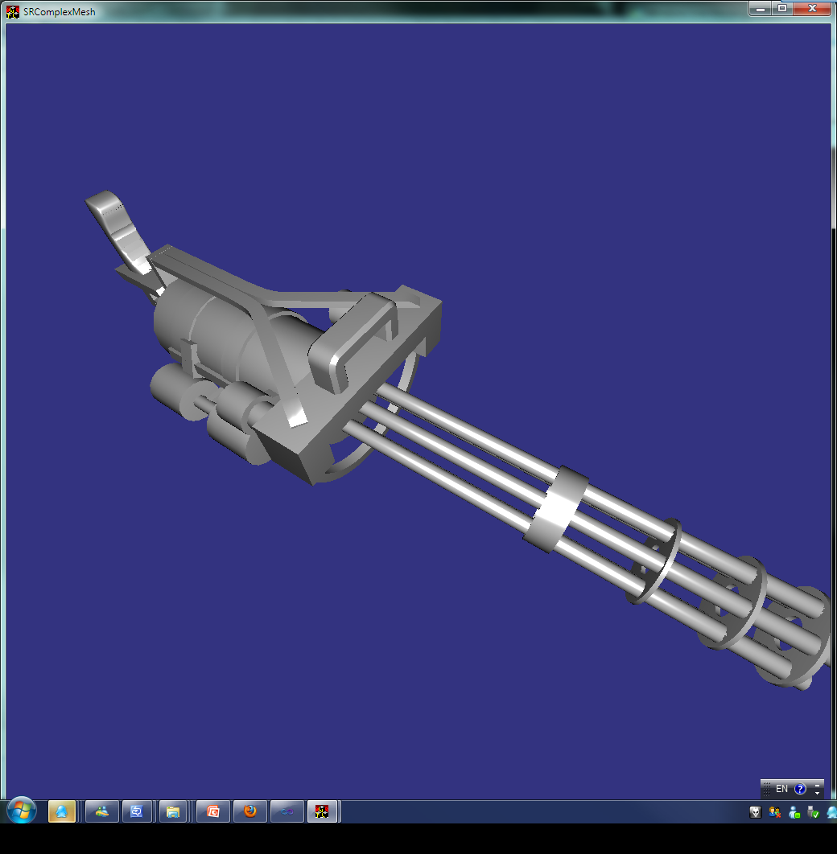
Complex mesh with per pixel lighting

Slide 10
Conclusion and future work
Limitation of CPU
SALVIA encounters
Possible methods to solve
Future work
More samples and test cases
Further optimization
More features
Generate code for GPU
Notes:
The last but not the least, we will list the limitation of CPU that SALVIA encounters, and summarize possible methods to solve these problems.
After that, future work will be briefly talked about in formal.

Slide 11
Thank you!

